Slide 1


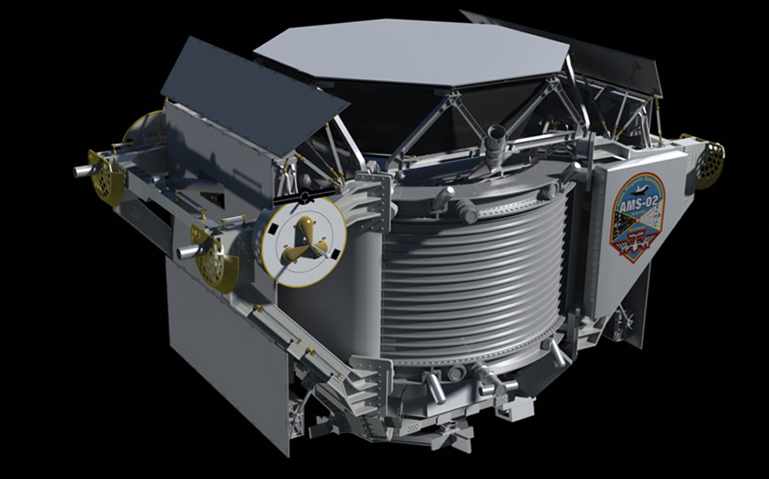
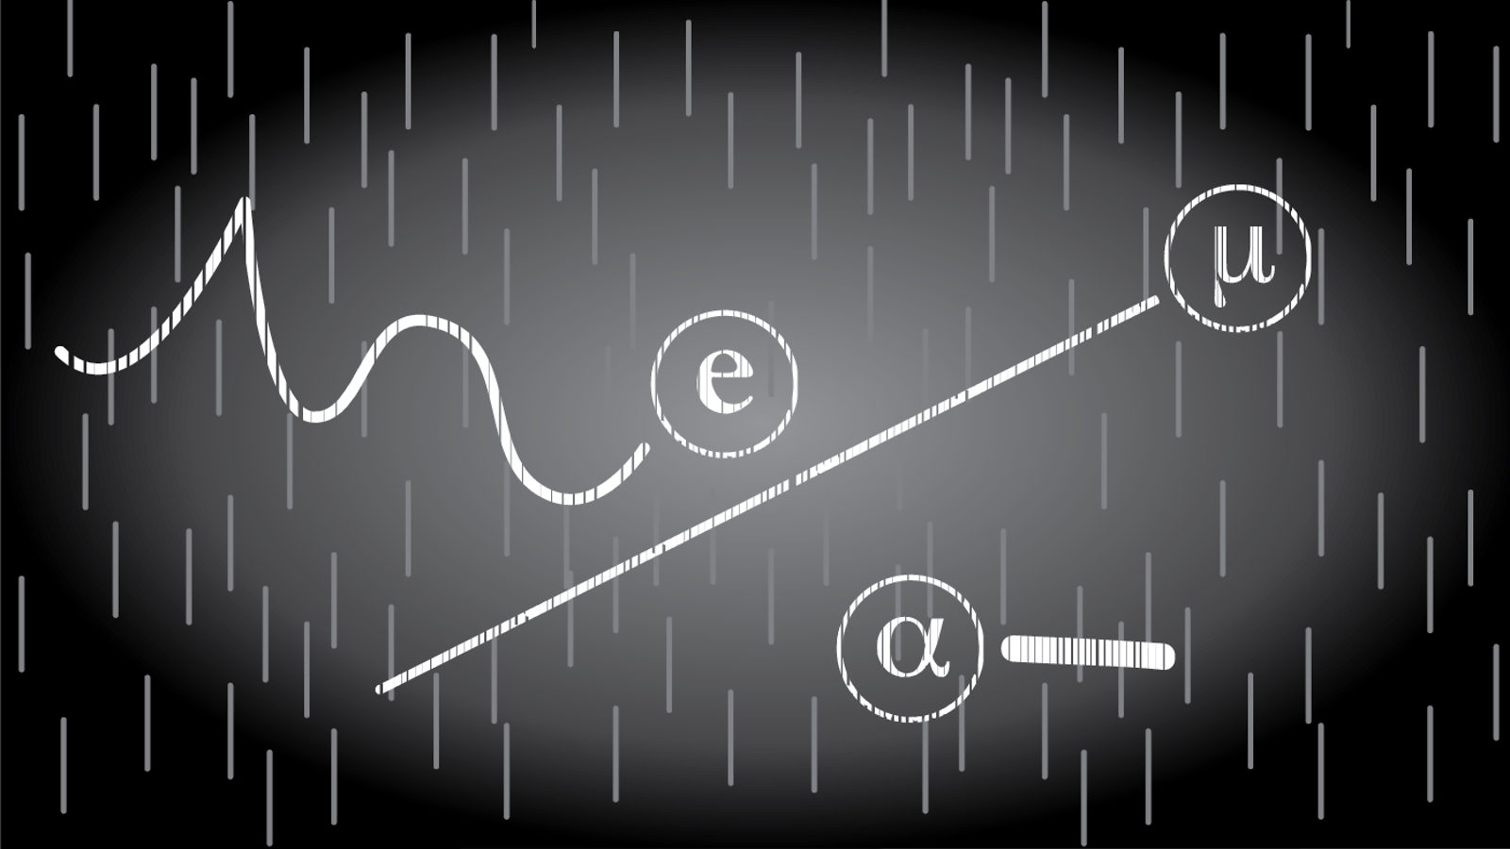
Particle Detector Project Close and Lessons Learned Meeting
Matilde Mazzini and Giorgia Mazzini
Issue: 24 May 2017
Artwork by NASA, Unknown. AMS Image on black [Photograph].
Retrieved from https://ams.nasa.gov/images_Overall_Summary_Photos.html
Artwork by Sandbox Studio, Chicago. Particles [Photograph]. Retrieved from
http://www.symmetrymagazine.org/article/january-2015/how-to-build-your-own-particle-detector
Notes:
Hello everybody! Welcome to our last meeting.

Slide 2
Particle Detector Project – Close, Lessons Learned
Outline
Introduction
Goals and Objective
Project Schedule
Acceptance Test Results
Trip to Big Island
Deliverablees
The Journey
Lessons Learned
Next Steps
Thank You
Notes:
Today we are going to summarize the goals and objective of our project, present the results of our trip to Big Island and we will talk for a while about the lessons we learned and the awsome journey he did.

Slide 3
Particle Detector Project – Close, Lessons Learned
Introduction
Matilde Mazzini
School: University of Pisa
Major: Computer Engineering
Career Interest: Computer Graphics
Hobby: Theatre
Giorgia Mazzini
School: University of Firenze
Major: Electrical Engineering
Career Interest: Robotics and Home Automation
Hobby: Kickboxing
Notes:
As always I am Giorgia and this is Matilde

Slide 4
Particle Detector Project – Close, Lessons Learned
Project Team
Project Sponsor:
Dr. Veronica Bindi (UHM, Dept of Physics and Astronomy)
Cheryl Sato Ishii (SPA)
Project Manager: Davin Sasaki (SPA)
Engineering Students: Matilde Mazzini, Giorgia Mazzini
SPA Support: Ryan Sugamoto, Clyde Kobashigawa
Space Science Outreach: Mary Kadooka, Sylvia Rocchi
Graduate Students: Katie Whitman, Claudio Corti
Notes:
And Those are the precious components of our team.

Slide 5
Particle Detector Project – Close, Lessons Learned
Goals and Objectives
Project Objectives: Actively involve students(high and middle school) in an inexpensive and simple scientific project. Known components. Modify features.
Goal: Build a detector prototype capable of detecting particles. Provide the software to pilot the device, to acquire data and to perform simple analyses.
Notes:
Here is a reminder of what was our initial project. We wanted to build a detector prototype capable of detecting particles with inexpensive, easy to find and simple components in order to make this device attractive to students.

Slide 6
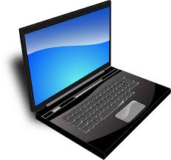
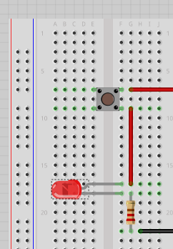
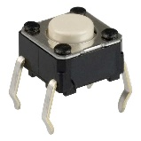
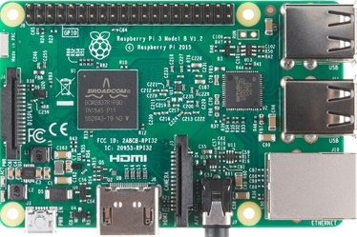
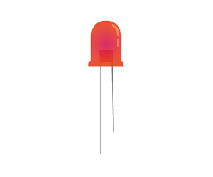
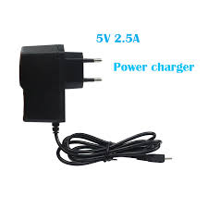
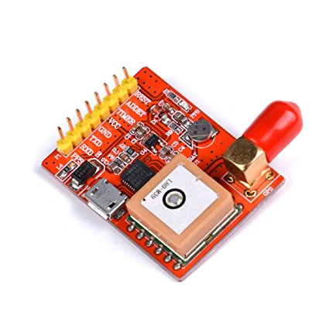
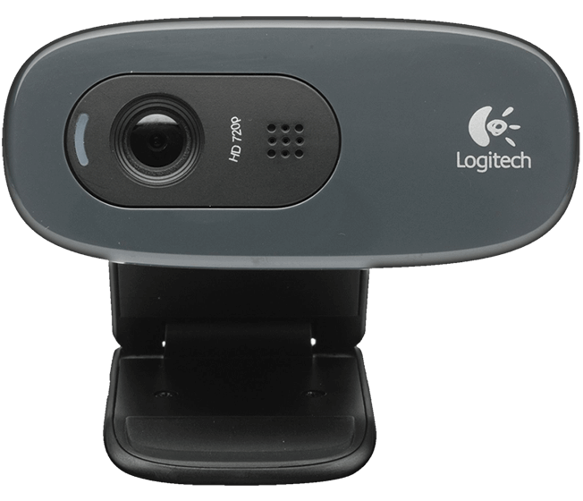
Particle Detector Project – Close, Lessons Learned
Block Diagram – System
Switch button
Protoboard
http://laserpointerforums.com/f51/what-kind-switches-these-37117.html
https://pixabay.com/it/portatile-black-blu-schermo-33521/
https://computers.tutsplus.com/tutorials/how-to-use-a-breadboard-and-build-a-led-circuit--mac-54746
LED
https://www.raspberrypi.org/learning/python-quick-reaction-game/requirements/
https://hobbytronics.com.pk/product/raspberry-pi-3-model-b/
5V 2.4A Power Supply
GPS Module for Raspberry PI 3B
Webcam Logitech c270
https://es.aliexpress.com/w/wholesale-usb-charger-raspberry-pi-3.html
https://www.amazon.com/Makerfocus-Raspberry-Module-Converter-USB-Port-GPS/dp/B01MXRZRDD
https://assets.logitech.com/assets/55372/webcam-c270-gallery.png
Notes:
Here is a skeme of how he built up our device and the components we used.
So The most important is of course the Raspberry Pi board, that is such a powerfull device.
And then we used a webcam and a Gps module

Slide 7
Particle Detector Project – Close, Lessons Learned
Milestone Schedule
3/13: Kick Off Meeting - Done
4/18: Design Review - Done
4/25: Build Prototype and Test - Done
5/11: Acceptance Test - Done
5/15-17: Test on Maunakea - Done
5/24: Project Close and Lessons Learned
Today
Mar 26, '17
Apr 16, '17
May 7, '17
Start Mon 3/13/17
Finish Fri 5/26/17
Kickoff Meeting Mon 3/13/17
Design Review Tue 4/18/17
Acceptance Test Thu 5/11/17
Complete Prototype and Test Tue 4/25/17
Project Close and Lessons Learned Wed 5/24/17
Notes:
After we met for the acceptance test we actually did a trip to big island, with the purpose of taking data in the top of Maunakea.
today the 24° of may we are going to close the project.

Slide 8
Particle Detector Project – Close, Lessons Learned
Acceptance Test Results (1 of 2)
# | ID | Specification | Type | Test Method | Verification | Pass/Fail
1 | SW2 | Shall be able to turn on and off manually | Software | Turn on and off the Particle Detector Program from the LXTerminal of Raspberry (Desktop Mode) | Test | Yes
2 | SW3 | Shall be able to turn on and off, without keyboard/mouse and monitor (Headless mode) | Software | External battery pack + Headless Mode (Access Point) | Test | Yes
3 | HW2 | Shall have a button that starts the detection program | Hardware | Use your Phone (before spec SW2 is needed) | Test | Yes
4 | SY2 | Shall be able to capture and store data to the SD Card | System | RSB does it automatically. Search in Pi directory | Test | Yes
5 | SY4 | The Raspberry Pi shall be able to count the number of rays that are detected in a given time | System | Python Code. The program returns the number | Test | Yes
6 | HW5 | Shall have LEDs indicating the process of program and/or eventual errors | Hardware | Connect LED to protoboard. Python Code | Test | Yes
7 | SY3 | Shall be able to add GPS data to the filtered frames | System | Python Code. The program returns the list of all exif data | Test | Yes
Notes:
Last time we met in the Acceptance Test meeting we have been through those specifications that we wanted for our project.
Here you can see which ones are passed and which ones still need to be accomplished.

Slide 9
Particle Detector Project – Close, Lessons Learned
Acceptance Test Results (2 of 2)
# | ID | Specification | Type | Test Method | Verification | Pass/Fail
8 | SW1 | Shall be able to provide the following data: number of event, timelapse, image, GPS data. | Software | Using GPS Module. Python Code. The program saves a file with all data | Test | Yes
9 | HW1 | Shall have the capability to detect cosmic ray particles | Hardware | Using a source to analyse data (if using it or not using it, the program gives different results, then it means it detects particles) | Test | Yes
10 | SY1 | Shall be able to reset the system | System | Reset Command(in both Desktop and Headless mode) or Battery Pack with On/Off Button | Test | Yes
11 | HW3 | Weight | Hardware | To be measured | Inspection | No
12 | HW4 | Dimensions | Hardware | 28x22x6 cm | Inspection | Yes
13 | SY5 | Shall have an Introduction on how to use the system document | System | Tutorial/Daily Report | Test | Yes
14 | SY6 | Shall have an Assembly Instructions on how to put the system together | System | Tutorial/Daily Report | Test | Yes
15 | SY7 | The system shall be safe for students to handle | System | TBD | Test
16 | SW6 | Shall be able to send data to server | Software | TBD | Test | No
Notes:
For examples here we can see that We wanted to build a device that was able send data to a server but we did not have time to do this. maybe the next intern Florine can

Slide 10
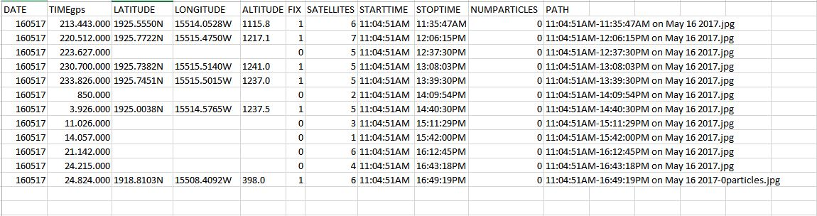
Particle Detector Project – Close, Lessons Learned
Before Big Island
Code improved: take GPS data every 30 mins. Logfile.csv can be imported in Excel. Possibility to interpolate the positions.
What did we expect? More particles because we are in a higher altitude level even if the efficiency is very low = better results!
Notes:
Before leaving for big island
After our last meeting with Davin we decided to improve our code by adding few lines in the code, in order to be able to take GPS data every 30 minutes.
This information, is recorded in a log file (.csv is the file format) , that can also be easily USED WITH Excel.
In future it can be nice also to interpolate all this position we acquired and see the whole path of the experiment!
This is an example of how a logfile looks like.
what did we expect before leaving?
We already knew that the value of the efficiency of our sensor is very very low, but we were also pretty sure that with a higher altitude(the top of maunakea is almost 13 tausand 8 hundred feet) we can have better results!

Slide 11
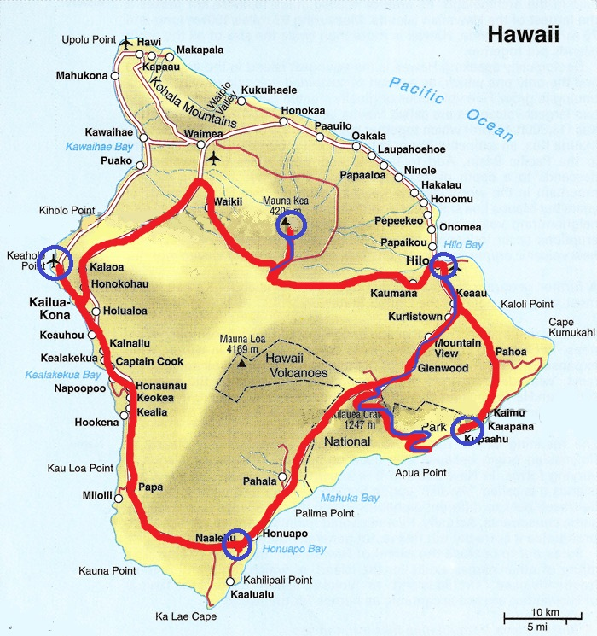
Particle Detector Project – Close, Lessons Learned
Big Island Trip
2017\05\15 Kona – Maunakea – Hilo
2017\05\16 Hilo – Volcano Park – Naalehu
2017\05\17 Naalehu – Kona
Notes:
We did 7 different experiments

Slide 12
Particle Detector Project – Close, Lessons Learned
Big Island Experiments
DATE | PLACE | START | STOP | TIME LAPSE | COUNTED EVENT
2017\05\15 | Plane Hnl-Kn | 9:38 | 10:56 | 1h | 0
 | Maunakea | 16:52 | 19:53 | 3h | 0
 | B&B in Hilo | 00:16 | 07:28 | 7h | 6
2017\05\16 | Hilo to VNP | 11:04 | 16:49 | 5h | 0
 | Kupaahu (Bikes) | 17:19 | 23:19 | 6h | 3
 | B&B in Naalehu | 00:17 | 08:40 | 8h | 1
2017\05\17 | Plane Kn-Hnl | 21:04 | 21:51 | 1h | 0
Notes:
(VNP =Volcano National Park)
So here you can see all the data we acquired in our trip to big island. This is the date…. total TIMELAPSE OF EVERY EVENT
The first thing that lights up from that list, is the low number of detected particles, that is different from 0 just in those 3 cases,
even if the timelapse of the experiments is quite long.
In bold you can see the most significant result we had.
In addition to all, there was a problem we had to face up to it’s that the GPS was not working on the plane, so the logfile we wrote when we were on the plane (first and last exp) is actually without position!
THRESHOLD
(In this column you can see that this value starts higher and gets lower. What is this? What it means?
This is a value that discriminates the RGB level of the pixel that the the code is analysing (above it the pixel are set white below they are set black.) Before going to Big Island we actually saw particles with that value set to 25. But after the first two experiments with no results we were a bit worried and disappointed so we decided to try to set it at the minimum. Anyway, after those 7 experiments, we can see that this doesn’t change so much for the particle detector.)

Slide 13
Particle Detector Project – Close, Lessons Learned
After Big Island
What I can see from those experiments:
- Acquisition data time too long.
- Small sensor size.
- More stability needed.
Conclusion:
We didn’t have the increase that we expected before.
Device not so good as a Cosmic Ray Detector.
Device excellent as an Artificial Radiation Detector.
How can we upgrade the device?
New gps;
Camera with a bigger sensor;
Maybe more cameras in parallel
Notes:
What I can see from those experiments:
The detector needs very long time of data acquisition to measure something because the rate is low.
The sensor is very small.
We also understood that The detector needs to be stabilized in a position parallel to the floor in order to detect the maximum flux of particles!
In conclusion we didn’t have the increase that we expected, by changing so much the altitude.
So, we can say that the detector is too little sensitive to be a good Cosmic Ray Detector, but, as we saw in the past meetings and experiments the device can be an excellent Artificial Radiation Detector. In fact in«starry night», the first experiments we did: despite the very low radioactivity of the source, we had a rate of 6 particles per minute, that is actually quite high.
So those are suggestion to eventually upgrade the device in future:
-To change the gps, so that it can fix on satellites also in the plane.
-Try to find a still affordable camera, with a bigger sensor or to use more cameras in parallel.

Slide 14
Particle Detector Project – Close, Lessons Learned
Deliverables
Working Prototype (Detecting Particles + GPS Info)
How To Instructions
Documentation
Parts List
Notes:
This is the list of the things we have to provide to florine and to whoever wants to build up our project

Slide 15
Particle Detector Project – Close, Lessons Learned
Risk Review
POWER BANK:
Use Raspberry outside: need powerfull power bank.
It took few days to find a good one. Time was running out.
Mitigation: we borrowed one from a physics student. For the future, we suggest to buy a new one.
Notes:
After the design review we started to think about a solution to use the Raspberry outside without a socket. we needed a power bank capable to give enough power to all the complete device for multiple hours if we wanted to so experiment in big island, the time was running out and it took few days for us to find a good one and
Mitigation: we borrowed one from a physics student. For the future, we suggest to buy a new one.

Slide 16
Particle Detector Project – Close, Lessons Learned
Issues
ACCESS POINT Raspberry in headless mode in open areas. Write auto boot program. Too challenging. Raspberry as an Access Point! No available Wi-Fi needed: Raspberry creates its own network. Any device with Wi-Fi connection can remotely control it with the VNC application.
GPS NOT FIX ON SATELLITES During the experiment inside the plane the GPS couldn’t fix on satellites. Result without GPS data.
Notes:
Those are the new issues we said that if we need to use the raspberry without a monitor in open areas where there is not available wifi, we had to write an autoboot program that automatically starts when we switch on the Raspberry, then it came out that it was too challenging. No worries because we found an easier and faster way to solve this problem: We decided to make Raspberry an Access Point. Thank to this you don't need an available wifi connection : the Raspberry itself creates its own network. Any device with a Wifi connection can connect to the Raspberry network and remotely control it with the VNC application. (made to see in your laptop screen the desktop of the raspberry )

Slide 17
Particle Detector Project – Close, Lessons Learned
The Journey (The beginning)
At the beginning the language was a huge obstacle, the colloquial english is hard to understand. Tons of specific and tecnics term.
We made local hawaiian friends that helped us to improve our English. They always make fun of our accent and our mistakes. They also showed us typical and beautiful things hidden in the island.
Worried to not manage to do everything, huge expectations on us. In the end we did things we would have never expected to do.
Silvia gave us a lot of tips and tricks introducing us to Honolulu and UH.
Notes:
What was most difficult/challenging situation (e.g. communication, language, culture differences, technical knowledge, etc…)
At the beginning the language was a huge obstacle, we belived that we could understand english but instead we figured out that the colloquial english is really hard to understand, above all in a scientific enviroment in which there are tons of specific and tecnics term we had never haerd about like FORBUSH DECREASE.
We were lucky because we made local hawaiian friends that helped us to improve our English even if they were always making fun of our accent and our mistakes. we are happy they also showed us typical and beautiful things hidden in the island that only a local person can be aware of. (es tide pool hike maakapuu and lighthouse)
Another struggle we had, was at the very start when we did the first meeting with you: we were worried not to manage to do everything, we saw all of you with huge expectations on us, and we were worried not to be good enough. Well, we actually want to thank you because at the end we did things that we would have never expected to be able to do.
we are also glad that silvia gave us a lot of tips and triks in the beginning introducing us to honolulu and uh.

Slide 18
Particle Detector Project – Close, Lessons Learned
The Journey (People)
It was important to actively participate in the life of the department to meet a lot of people.
Attended the weekly colloquium in which experts were presenting their experiments. Opened our minds to how the scientific environment is wide, active, inspiring, stimulating.
The TGIF, every Friday people meet in the square outside to talk in front of a fresh beer. Met some guys from the electronics lab. They lent us tools and helped us to predict risks and give advice.
Physics students helped us to revise the python code and understand the theoretical physical part of the project.
Notes:
It was important to actively participate in the life of the department because we met a lot of people.
for example we often attended the weekly colloquium in which experts were presenting their experiments. The topics weren't our field so we didn't understand half of the conversations, but Those talks opened our minds to how the SAIENTIFIC scientific environment is wide, active, inspiring, and stimulating.
Another example is the tgif, the department is alive and every friday people meet in the square outside to talk in front of a fresh beer. here we meet some guys from the electronics laboratory in the second floor.
we talked a lot with them. They lent us tools (also the surfboards!) and with their knowledge background they helped us to predict the risks we did not think about and give advice on how to make the project more professional.
We also met physics students who helped us revise the python code and understand the theoretical physical part of the project.

Slide 19
Particle Detector Project – Close, Lessons Learned
Lessons Learned(1)
HOW TO PLAN AND ORGANIZE OUR STEPS: -Davin planned two weeks to write the documentation. For us 3-4 days were enough. He was right, we wish we had more time to write everything down! -Organization is crucial to work efficiently, define milestones is helpful to achieve results and stay focused. Daily report of all the steps, take stock of the situation. It’s easy to get lost and go off topic.
THINK POSITIVE! Dr Bindi: in life and work connections are important. Share knowledge, receive more opportunities for personal growth. To face challenges don’t panic! start from the easiest step and go on little by little.
Notes:
Those are things we wish we had known before start:
How to plan and organize our steps:
IN is schedule Davin planned that to write the documentation were necessary two weeks, we weren't convinced about it, we thought that 3-4 days were enough to write everything down, but in the end Davin was right, we wish we had more time to write everything down!
Organization is crucial to working efficiently, to define milestones is very helpful to achieve the result and stay focused. Keep reported everything you do and constantly take stock of the situation because in the sea of information that you are learning it’s easy to get lost and go off topic.
From Dr Bindi we learnt how to be positive and happy in every situation.
We also learnt that in life and work, is very important to create connections with people in order to share knowledge and receive more opportunities for personal growth.
Besides when you have to face up to something very challenging you don’t have to panic! You just need to calm down, start from the easiest step and go on little by little.

Slide 20
Particle Detector Project – Close, Lessons Learned
Lessons Learned(2)
Constantly experiment without being afraid of making errors or fail, open mind.
Matilde: To be confident of what I think and learn how to express my intuition to others, because in a team you need communication. Everyone must understand where and why an idea was born. When you have an intuition that can be valid, if you cannot explain it to others it is impossible to concretize it.
Giorgia: Before I was shy. Now I want to live with Aloha. Do not hide your negative aspects but use them to make you different!
Notes:
Constantly experiment without being afraid of failure be brave enought to put in practice what you are learning.
matilde realized that:
I would like to learn to be more confident of what I think and learn to express my intuition to others, because in a team you need communication. Everyone must understand where and why an idea was born. When you have an intuition that can be valid, if you cannot explain it to others it is impossible to concretize it and you contribute is useless.
giorgia realized that:
Before coming here I was very worried about what people think about you ( maybe because I live in a very small village ad you cannot go unnoticed)
I was very shy, afraid to be totally myself, and i was always trying to follow the others to not go out of the box. Here I learned how to be more chill, how to live with aloha and i realized that the negative aspects i was trying to hide (that more or less everyone tries to hide) are not actually negative! those are just the peculiarities that make you different,that make you interesting for other people and that obviously make you what you are!! So now I feel more confident

Slide 21
Particle Detector Project – Close, Lessons Learned
Next Steps
Packaging
Improvements:
Integrate New GPS Module
Camera with bigger sensors (or multiple cameras)
Upgrade it with NEW Sensors:
Temperature
Pressure
Scintillator and Photomultiplier
Notes:
We are almost at the end the presentation
improve our project with a new gps, eventually try a camera with a bigger sensor.
florine will do a specific cosmic ray detector with a scintillator and fotomultiplayer but it will be more difficult to distinguish the cosmic radiation from the radioactive one.

Slide 22


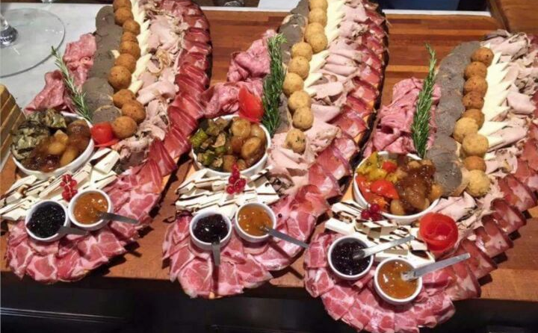
Particle Detector Project – Close, Lessons Learned
Giorgia and Matilde’s Next Steps!
Go back to Italy.
Study with new energy and emphasis.
Graduate as fast as we can.
Try to live a student life full of enthusiasm and aloha!!!!
Get to know Italy better, travel around beautiful places in Italy.
Do the longest Italian gastronomic tour ever after 3 months of abstinence.

Slide 23
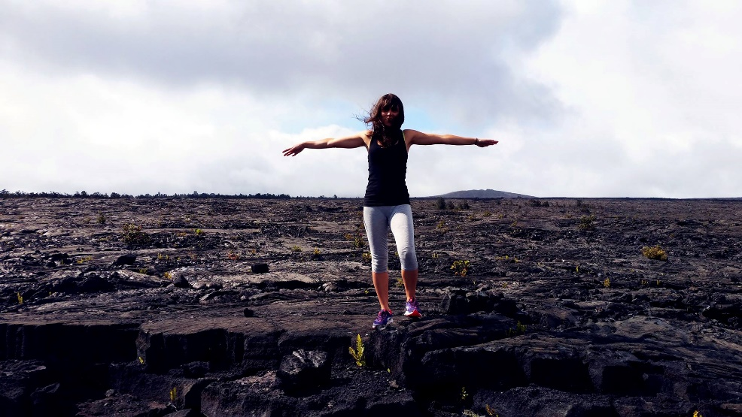
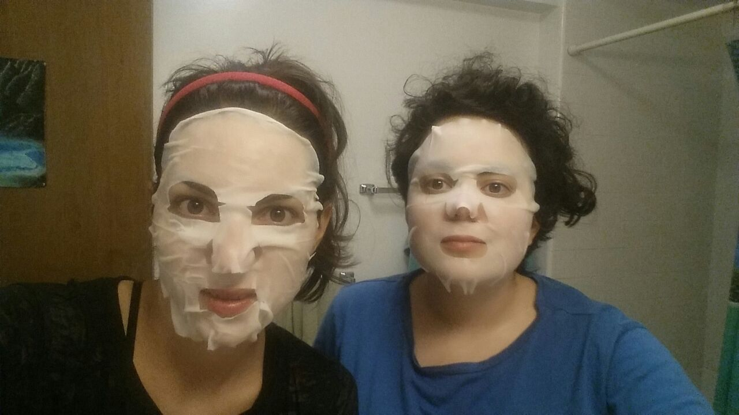
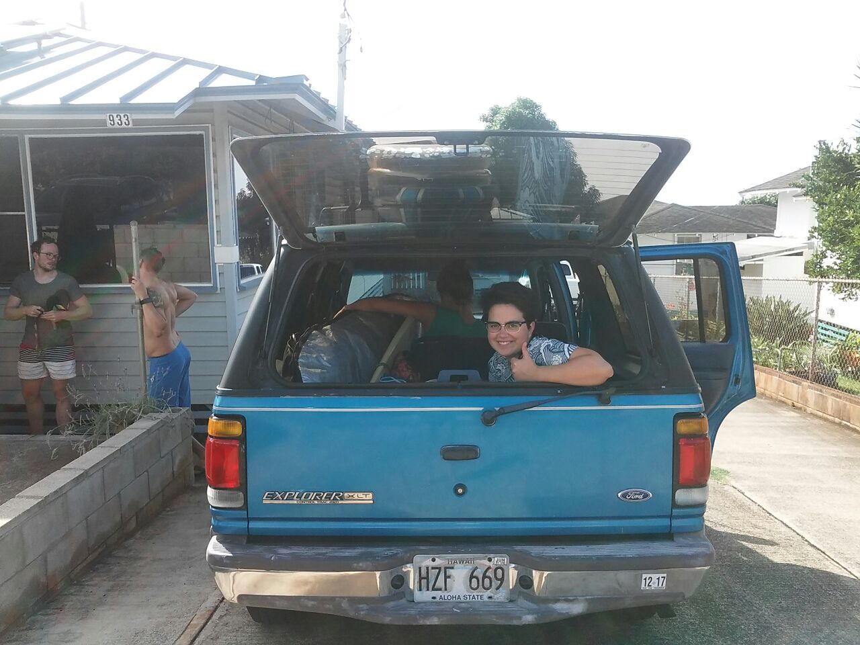
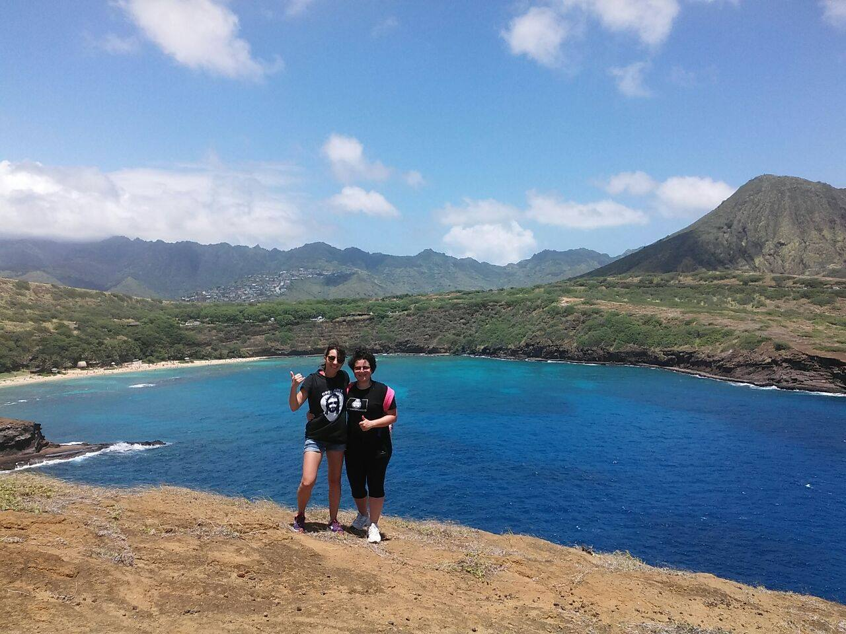
Particle Detector Project – Close, Lessons Learned
Enjoying Hawaii!

Slide 24
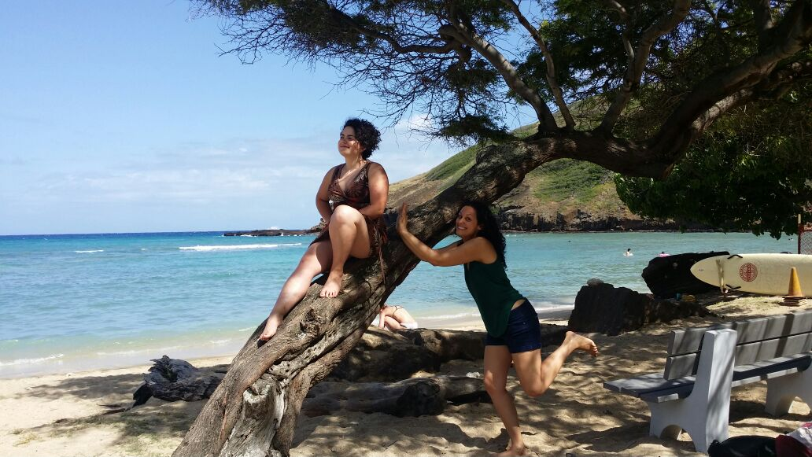
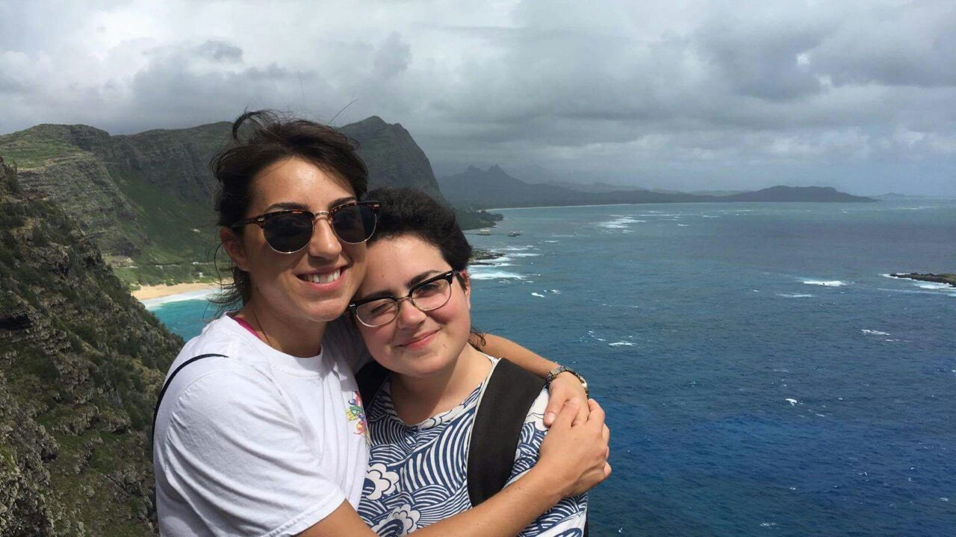
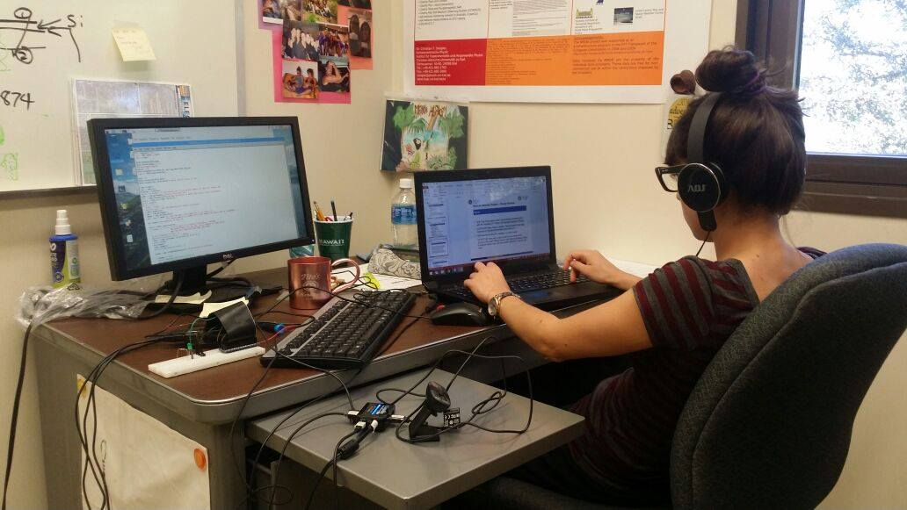
Particle Detector Project – Close, Lessons Learned
Enjoying Hawaii!

Slide 25
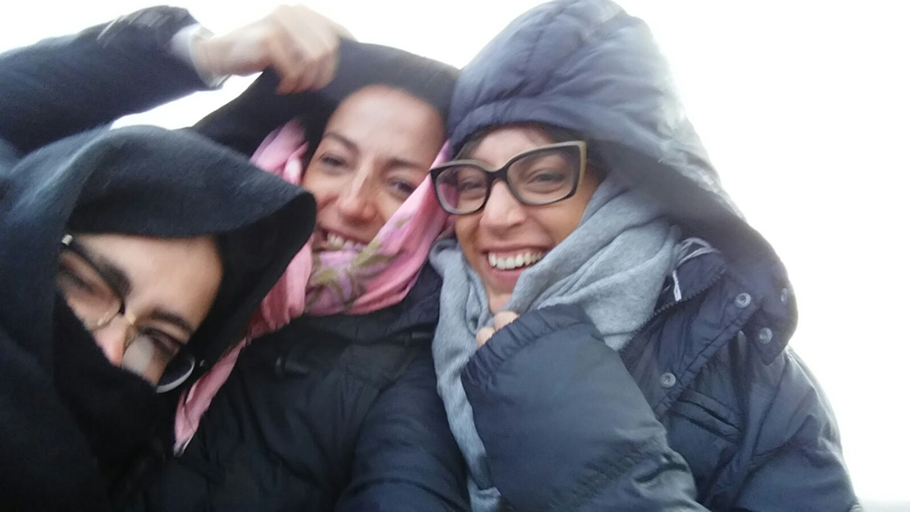
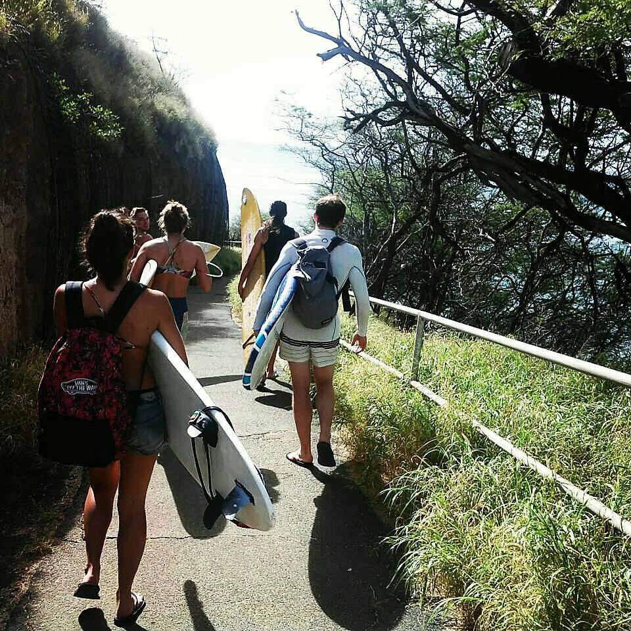
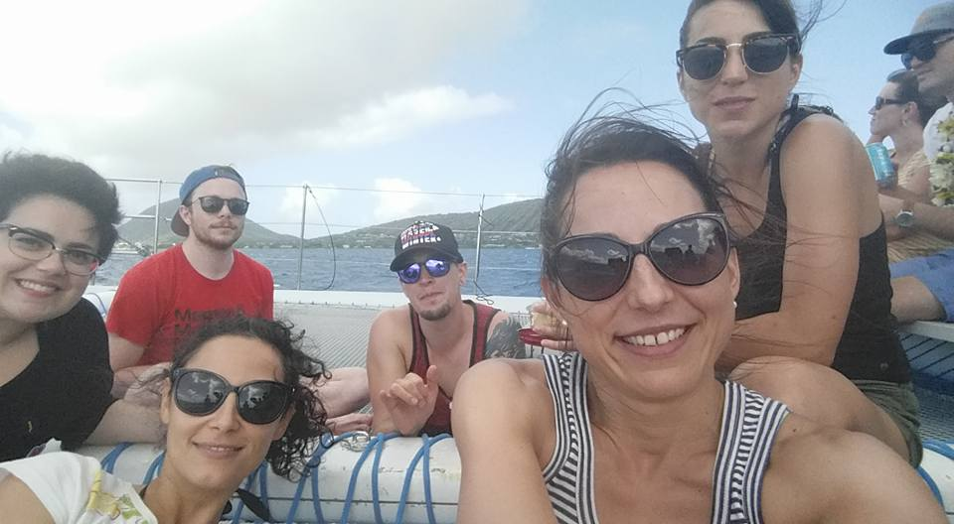
Particle Detector Project – Close, Lessons Learned
Enjoying Hawaii!

Slide 26
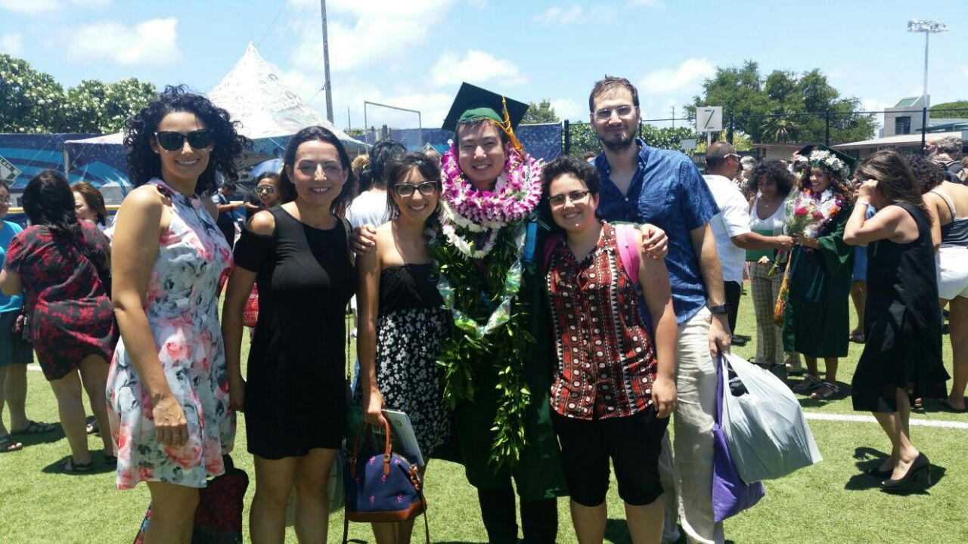
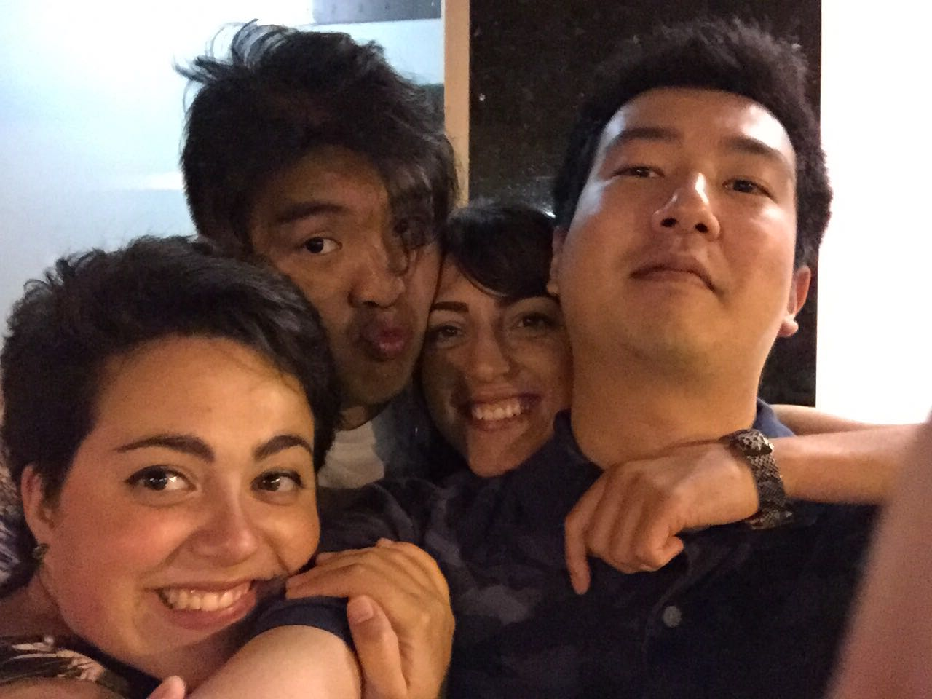
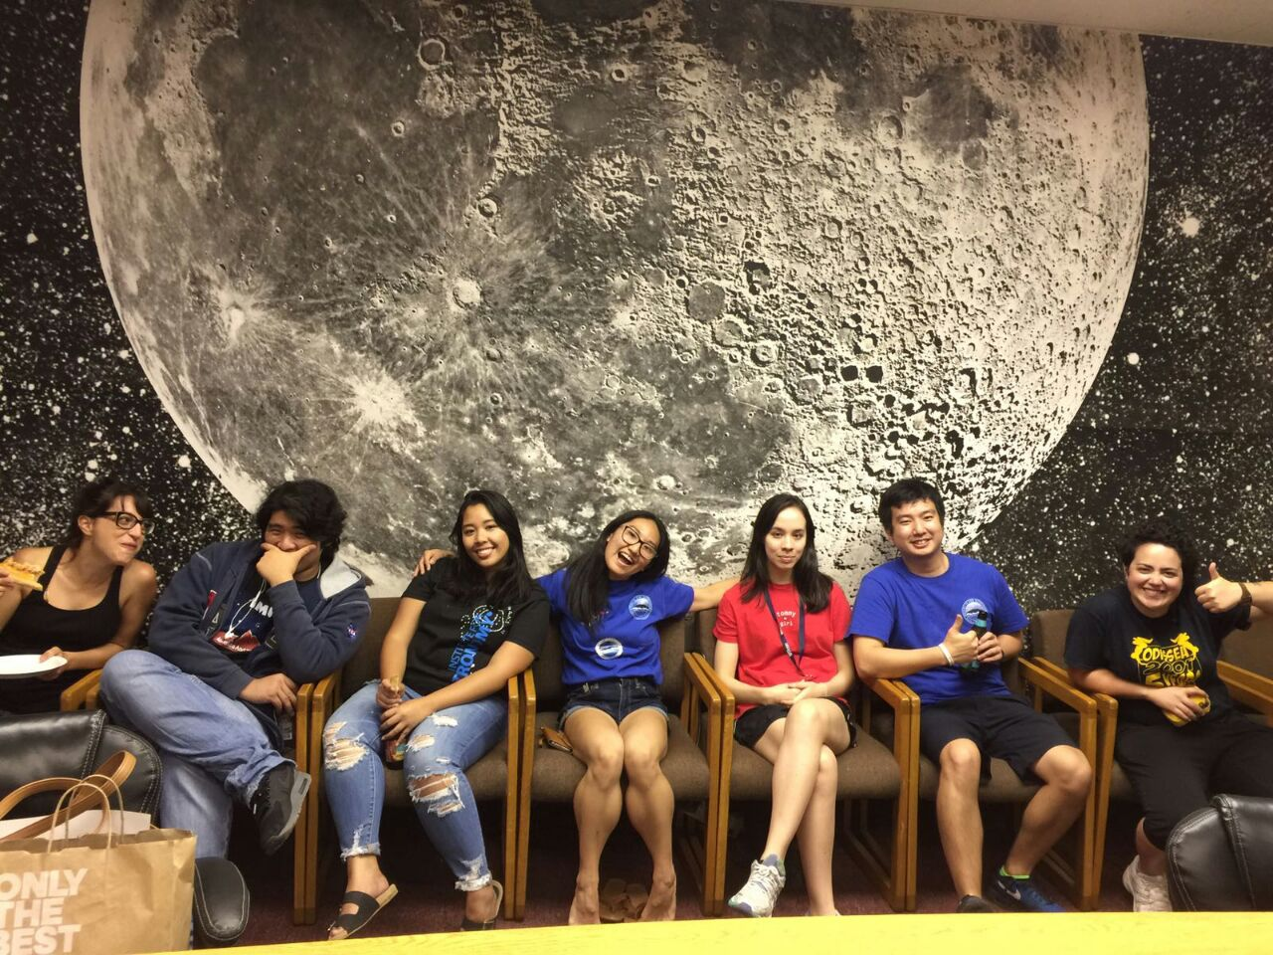
Particle Detector Project – Close, Lessons Learned
Enjoying Hawaii!

Slide 27
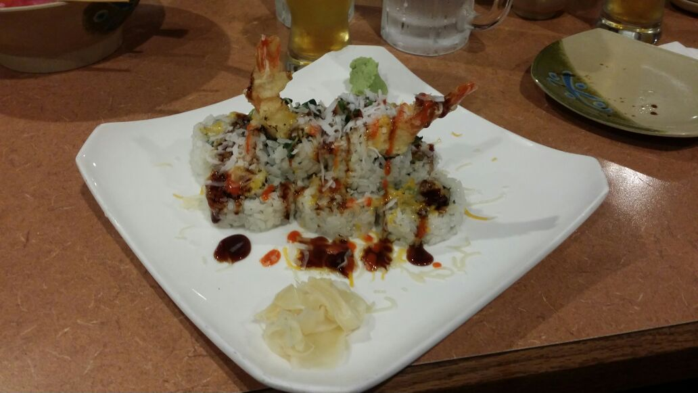
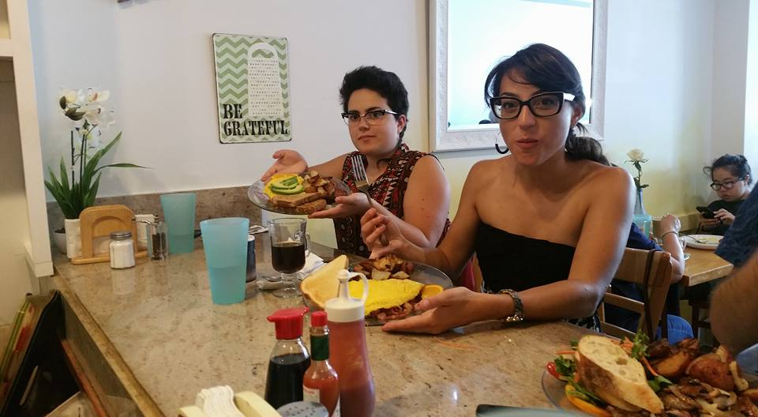
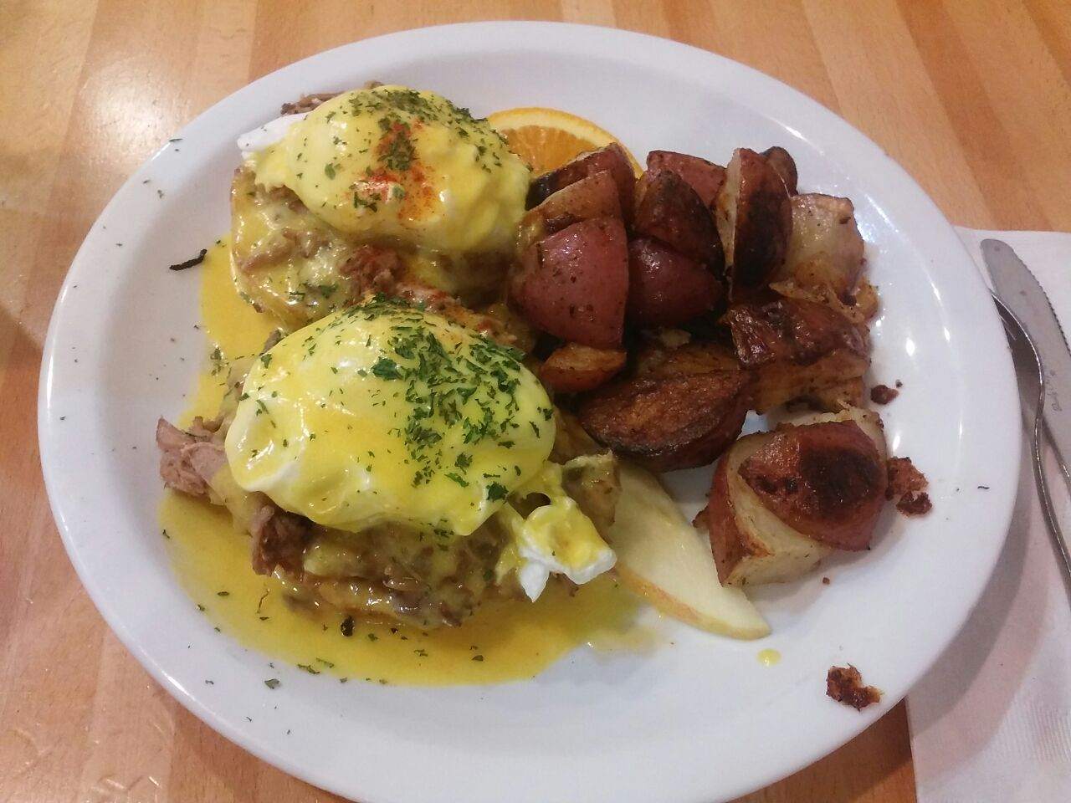
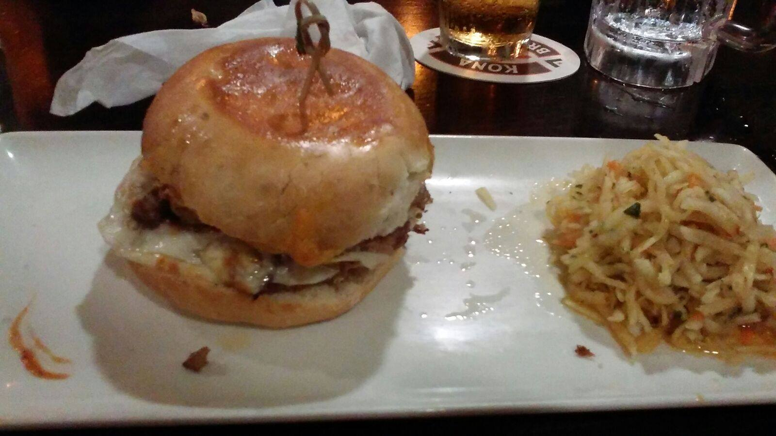
Particle Detector Project – Close, Lessons Learned
Enjoying Hawaii!

Slide 28
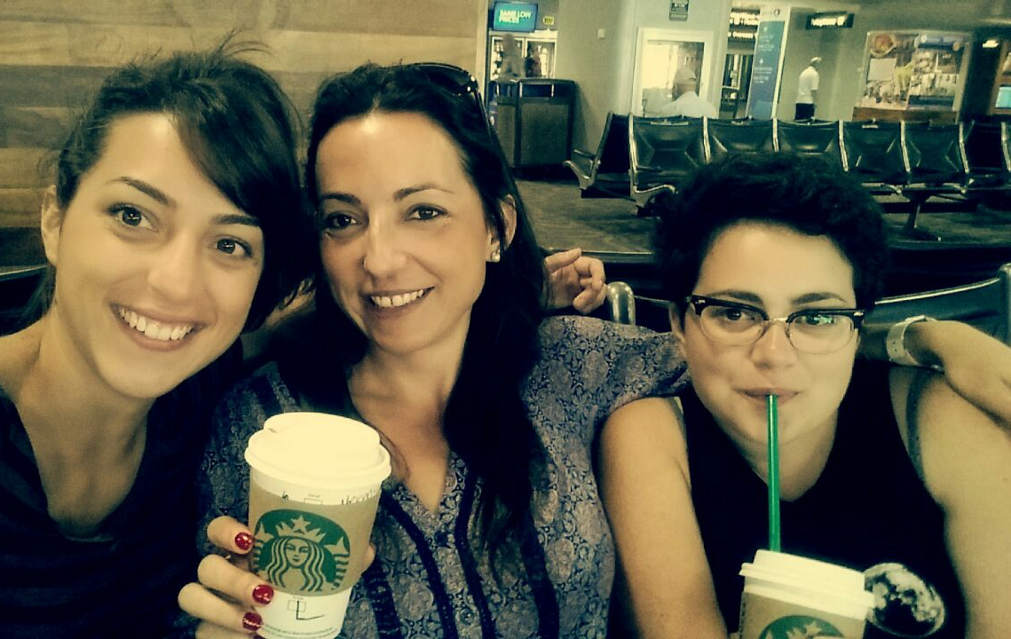
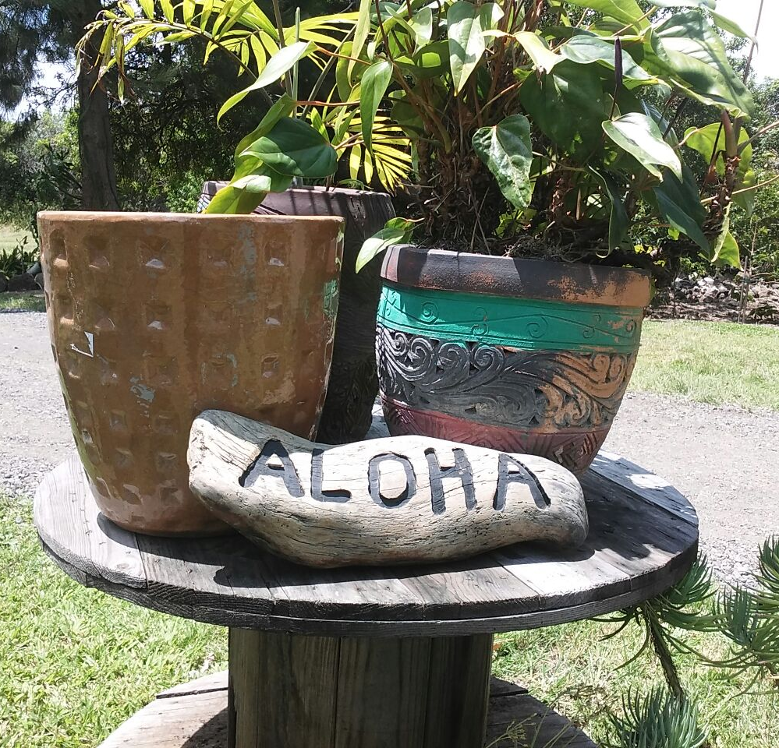
Particle Detector Project – Close, Lessons Learned
Thank You!
MAHALO!!!

Slide 29
Thank you for your attention
For further information please contact:
Matilde Mazzini
Computer Engineering
University of Pisa
Email: mmazzini@hawaii.edu
Giorgia Mazzini
Electrical Engineering
University of Florence
Email: gmazzini@hawaii.edu

